Slide 1
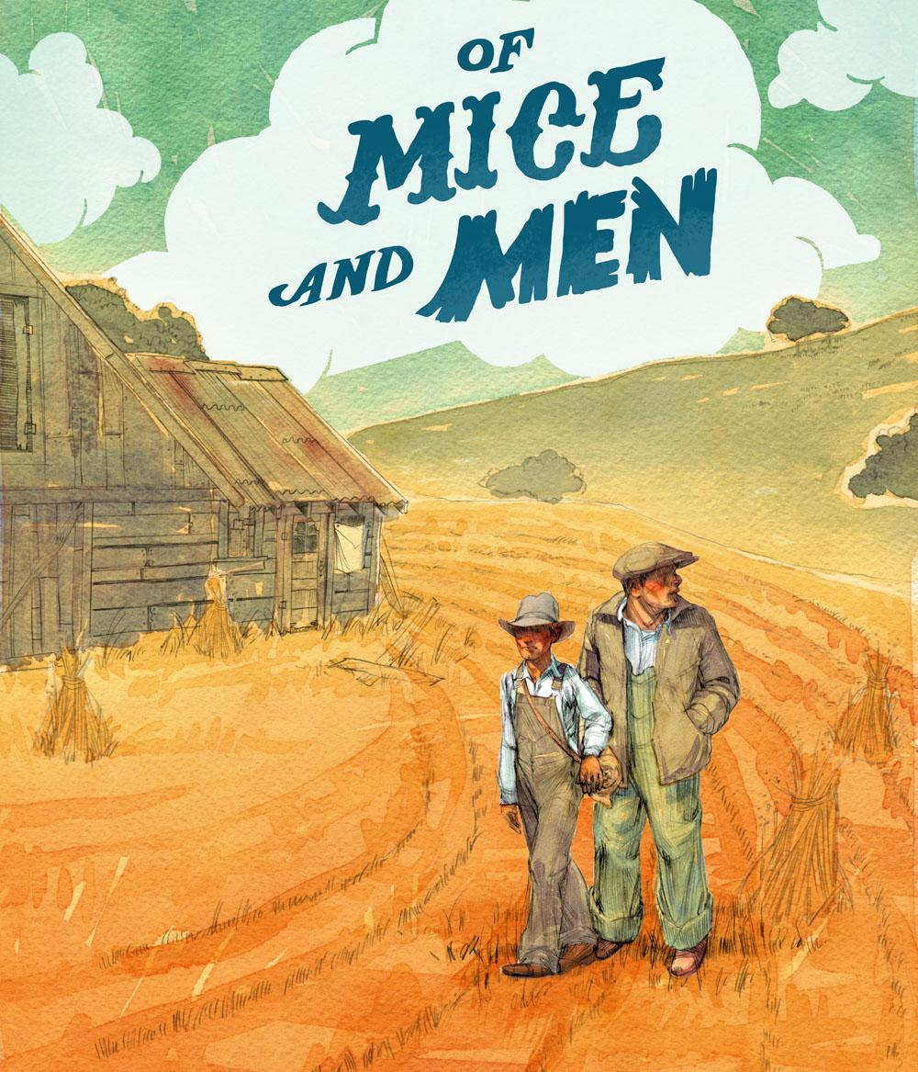
Background and Overview

Slide 2
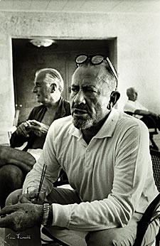
John Steinbeck- Author
Born February 27th in 1902 in Salinas, California, John was the third of four children, and the only son.
During his childhood, Steinbeck learned to appreciate his surroundings, and loved the Salinas countryside and the nearby Pacific Ocean; it would be this appreciation that would later come out in his writing.
Steinbeck worked during his summers as a hired hand in nearby ranches.

Slide 3
At The Time -
After World War I (1914-1918), economic and ecological forces brought many rural poor and migrant agricultural workers from the Great Plains states, such as Oklahoma, Texas, and Kansas, to California.
Following World War I, a recession led to a drop in the market price of farm crops, which meant that farmers were forced to produce more goods in order to earn the same amount of money.
The stock market crash of 1929 only made matters worse. Banks were forced to foreclose on mortgages and collect debts. Unable to pay their creditors, many farmers lost their property and were forced to find other work.

Slide 4
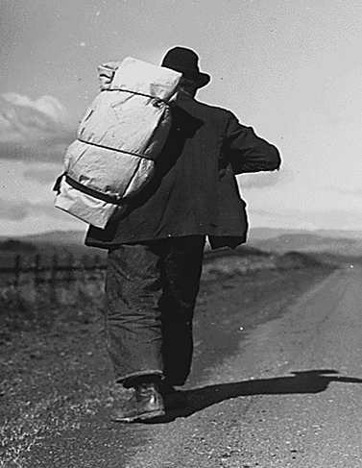
The Dust bowl and Migrant Workers
The increase in farming activity across the Great Plains states caused the precious soil to erode.
This erosion, coupled with a seven-year drought that began in 1931, turned once fertile grasslands into a desert-like region known as the Dust Bowl.
Hundreds of thousands of farmers packed up their families and few belongings, and headed for California, which, for numerous reasons, seemed like a promised land.
Migrant workers came to be known as Okies, for although they came from many states across the Great Plains, twenty percent of the farmers were originally from Oklahoma. Okies were often met with scorn by California farmers and natives, which only made their dislocation and poverty even more unpleasant.
A Bindlestiff

Slide 5
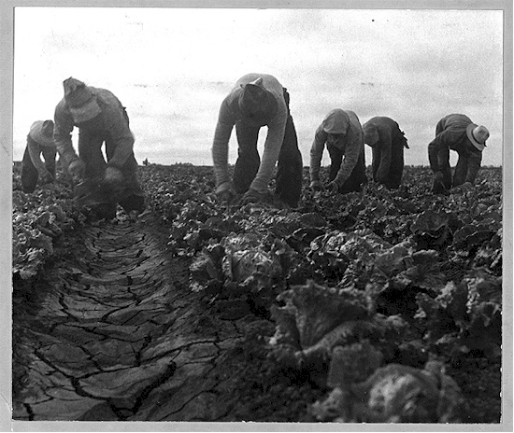
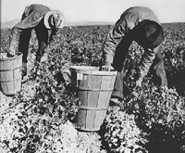
The Setting- Salinas, California- Fields
The novel is set in the farmland of the Salinas valley, where John Steinbeck was born.
The ranch in the novel is near Soledad, which is Southeast of Salinas on the Salinas river.
The countryside described at the beginning of the novel, and the ranch itself is based on Steinbeck’s own experiences.

Slide 6
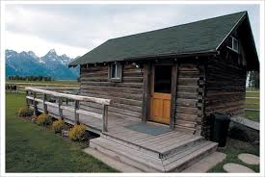
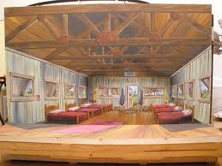
The Bunkhouse
The bunkhouse sets the scene for many of the scenes in the novel.
It is the temporary home for ranch workers, and Steinbeck uses it to depict the poverty and the humanity of the characters. Often, the novel reads like a play with characters entering and exiting this single place.

Slide 7
The Major Themes
The novel deals with the issues dear to Steinbeck’s heart - poverty, homelessness, the exploitation of itinerant workers, the failure of the Dream, America’s general moral decline.
Note how many of these themes are still very relevant today!!

Slide 8
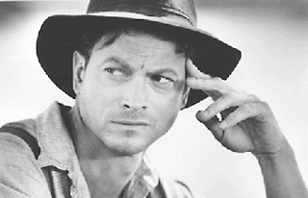
The Main Characters- George
George is a small, quick-witted man who travels with, and cares for, Lennie. Although he frequently speaks of how much better his life would be without his caretaking responsibilities, George is obviously devoted to Lennie. George’s behavior is driven by the wish to protect Lennie and, eventually, deliver them both to the ranch of their dreams. Though George is the source for the often-told story of life on their future ranch, it is Lennie’s childlike faith that enables George to actually believe his account of their future.

Slide 9
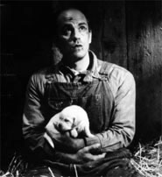
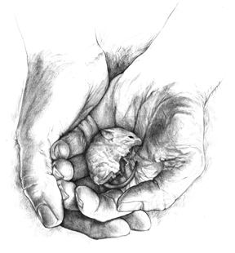
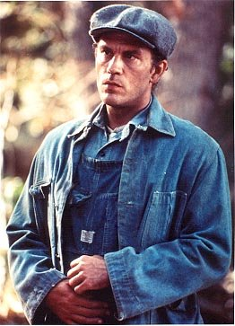
Lennie Small
Lennie is a oversized, clumsy, childlike migrant worker. Due to his mental frailty, Lennie completely depends upon George, his friend and traveling companion, for direction and security. Lennie believes in the ranch dream wholeheartedly. Gentle and somewhat innocent, Lennie nevertheless does not understand his own strength.

Slide 10
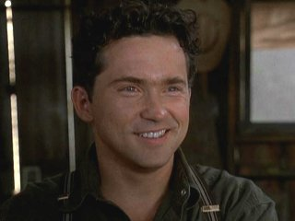
Minor Characters
Candy is an aging ranch handyman, Candy lost his hand in an accident and worries about his future on the ranch. He fears aging, that his age is making him useless.
Curley is the boss’s son and is quick to anger, even when he is wrong. He often mistreats the workers on the ranch.

Slide 11
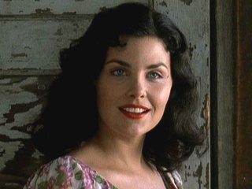
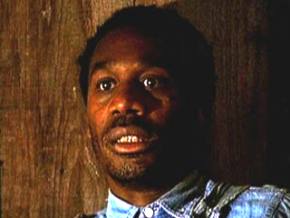
More Minor Characters
Curley’s wife is the only female character in the novel, Curley’s wife is never given a name and is only referred to in reference to her husband. The men on the farm refer to her as a “tramp,” a “tart,” and a “looloo.” She is desperately lonely and struggles to find purpose on the ranch.
Crooks, the black stable-hand, gets his name from his crooked back. He is proud, bitter, and caustically funny.

Slide 12
Other Characters
Slim - A highly skilled mule driver and the acknowledged “prince” of the ranch, Slim is the only character who seems to be at peace with himself. The other characters often look to Slim for advice.
Carlson - A ranch-hand, Carlson complains bitterly about Candy’s old, smelly dog. He convinces Candy to put the dog out of its misery.
The Boss - The stocky, well-dressed man in charge of the ranch, and Curley’s father. He is never named and appears only once, but seems to be a fair-minded man.
Aunt Clara - Lennie’s aunt, who cared for him until her death, does not actually appear in the novel except in the end, as a vision chastising Lennie for causing trouble for George.

Slide 13
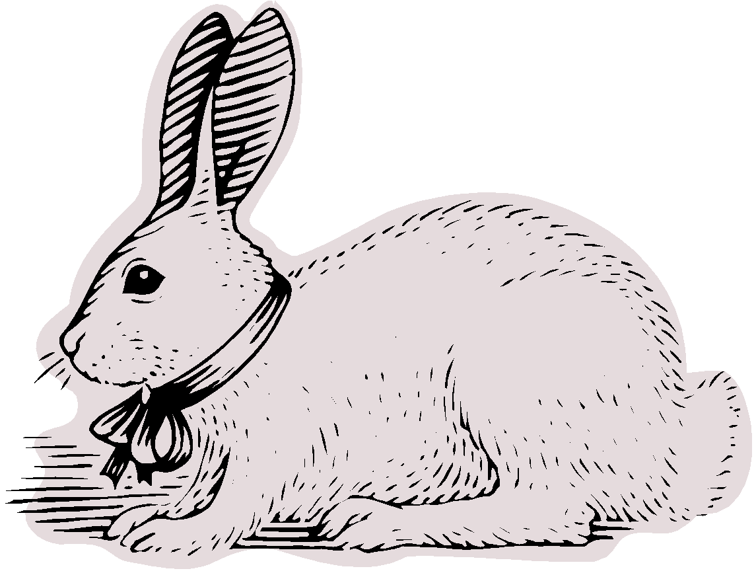
Themes to Look For
The American Dream-The American ideal tells that you can be successful here if you work hard for it. This is challenged by the Great Depression and the stock market Crash of 1929. Although the book is dark and grim the characters are searching for an opportunity to fulfill their dream of their own ranch.

Slide 14
Other Themes
Powerlessness
Steinbeck’s characters are often the underdogs, and he shows compassion toward them throughout the body of his writings. Powerlessness takes many forms—intellectual, financial, societal—and Steinbeck touches on them all
Fate
Life’s unpredictable nature is another subject that defines the human condition. Just when it appears that George and Lennie will get their farm, fate steps in.
Friendship and Empathy
Steinbeck makes the reader wonder whether mankind should go alone in the world or be responsible and helpful to others who are less fortunate.
Nature
Steinbeck uses nature images to reinforce his themes and to set the mood.

Slide 15
Now Read and enjoy the book!

